Slide 1
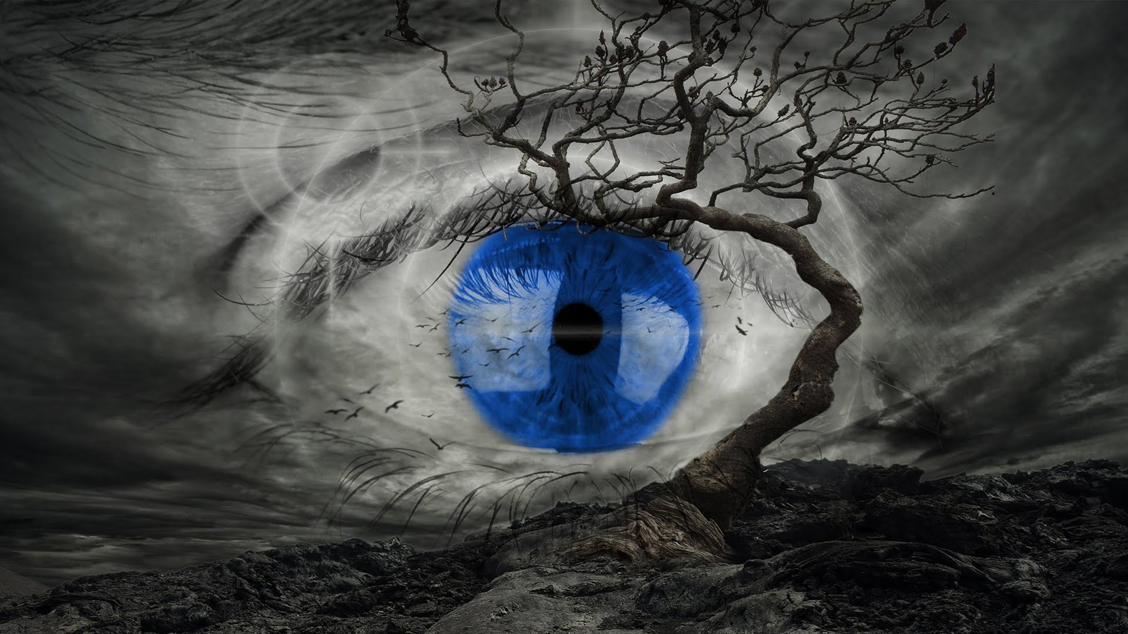
Visions – Often the simplest way to tell a story is a picture

Slide 2
Plan for this lecture
The good, the bad, the ugly and how to make things better
Good data visualisations are a great way of telling a story
Let’s look at some examples
Let’s learn some R commands for visualisations
Let’s try to make some new visualisations
In part based on lecture notes by Richard Davies

Slide 3
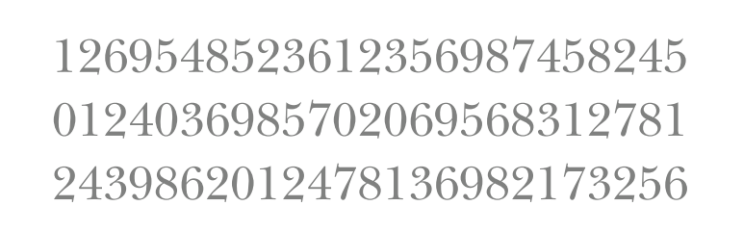
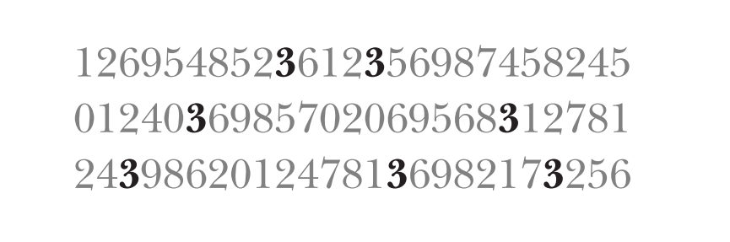
Why are figures great?
Attentive vs Pre-attentive processing
How often does the number 3 occur?
Attentive processing (serial)
Pre-attentive processing (parallel)
Pre-attentive processing is quicker
We can also already be misled before we even start to think

Slide 4
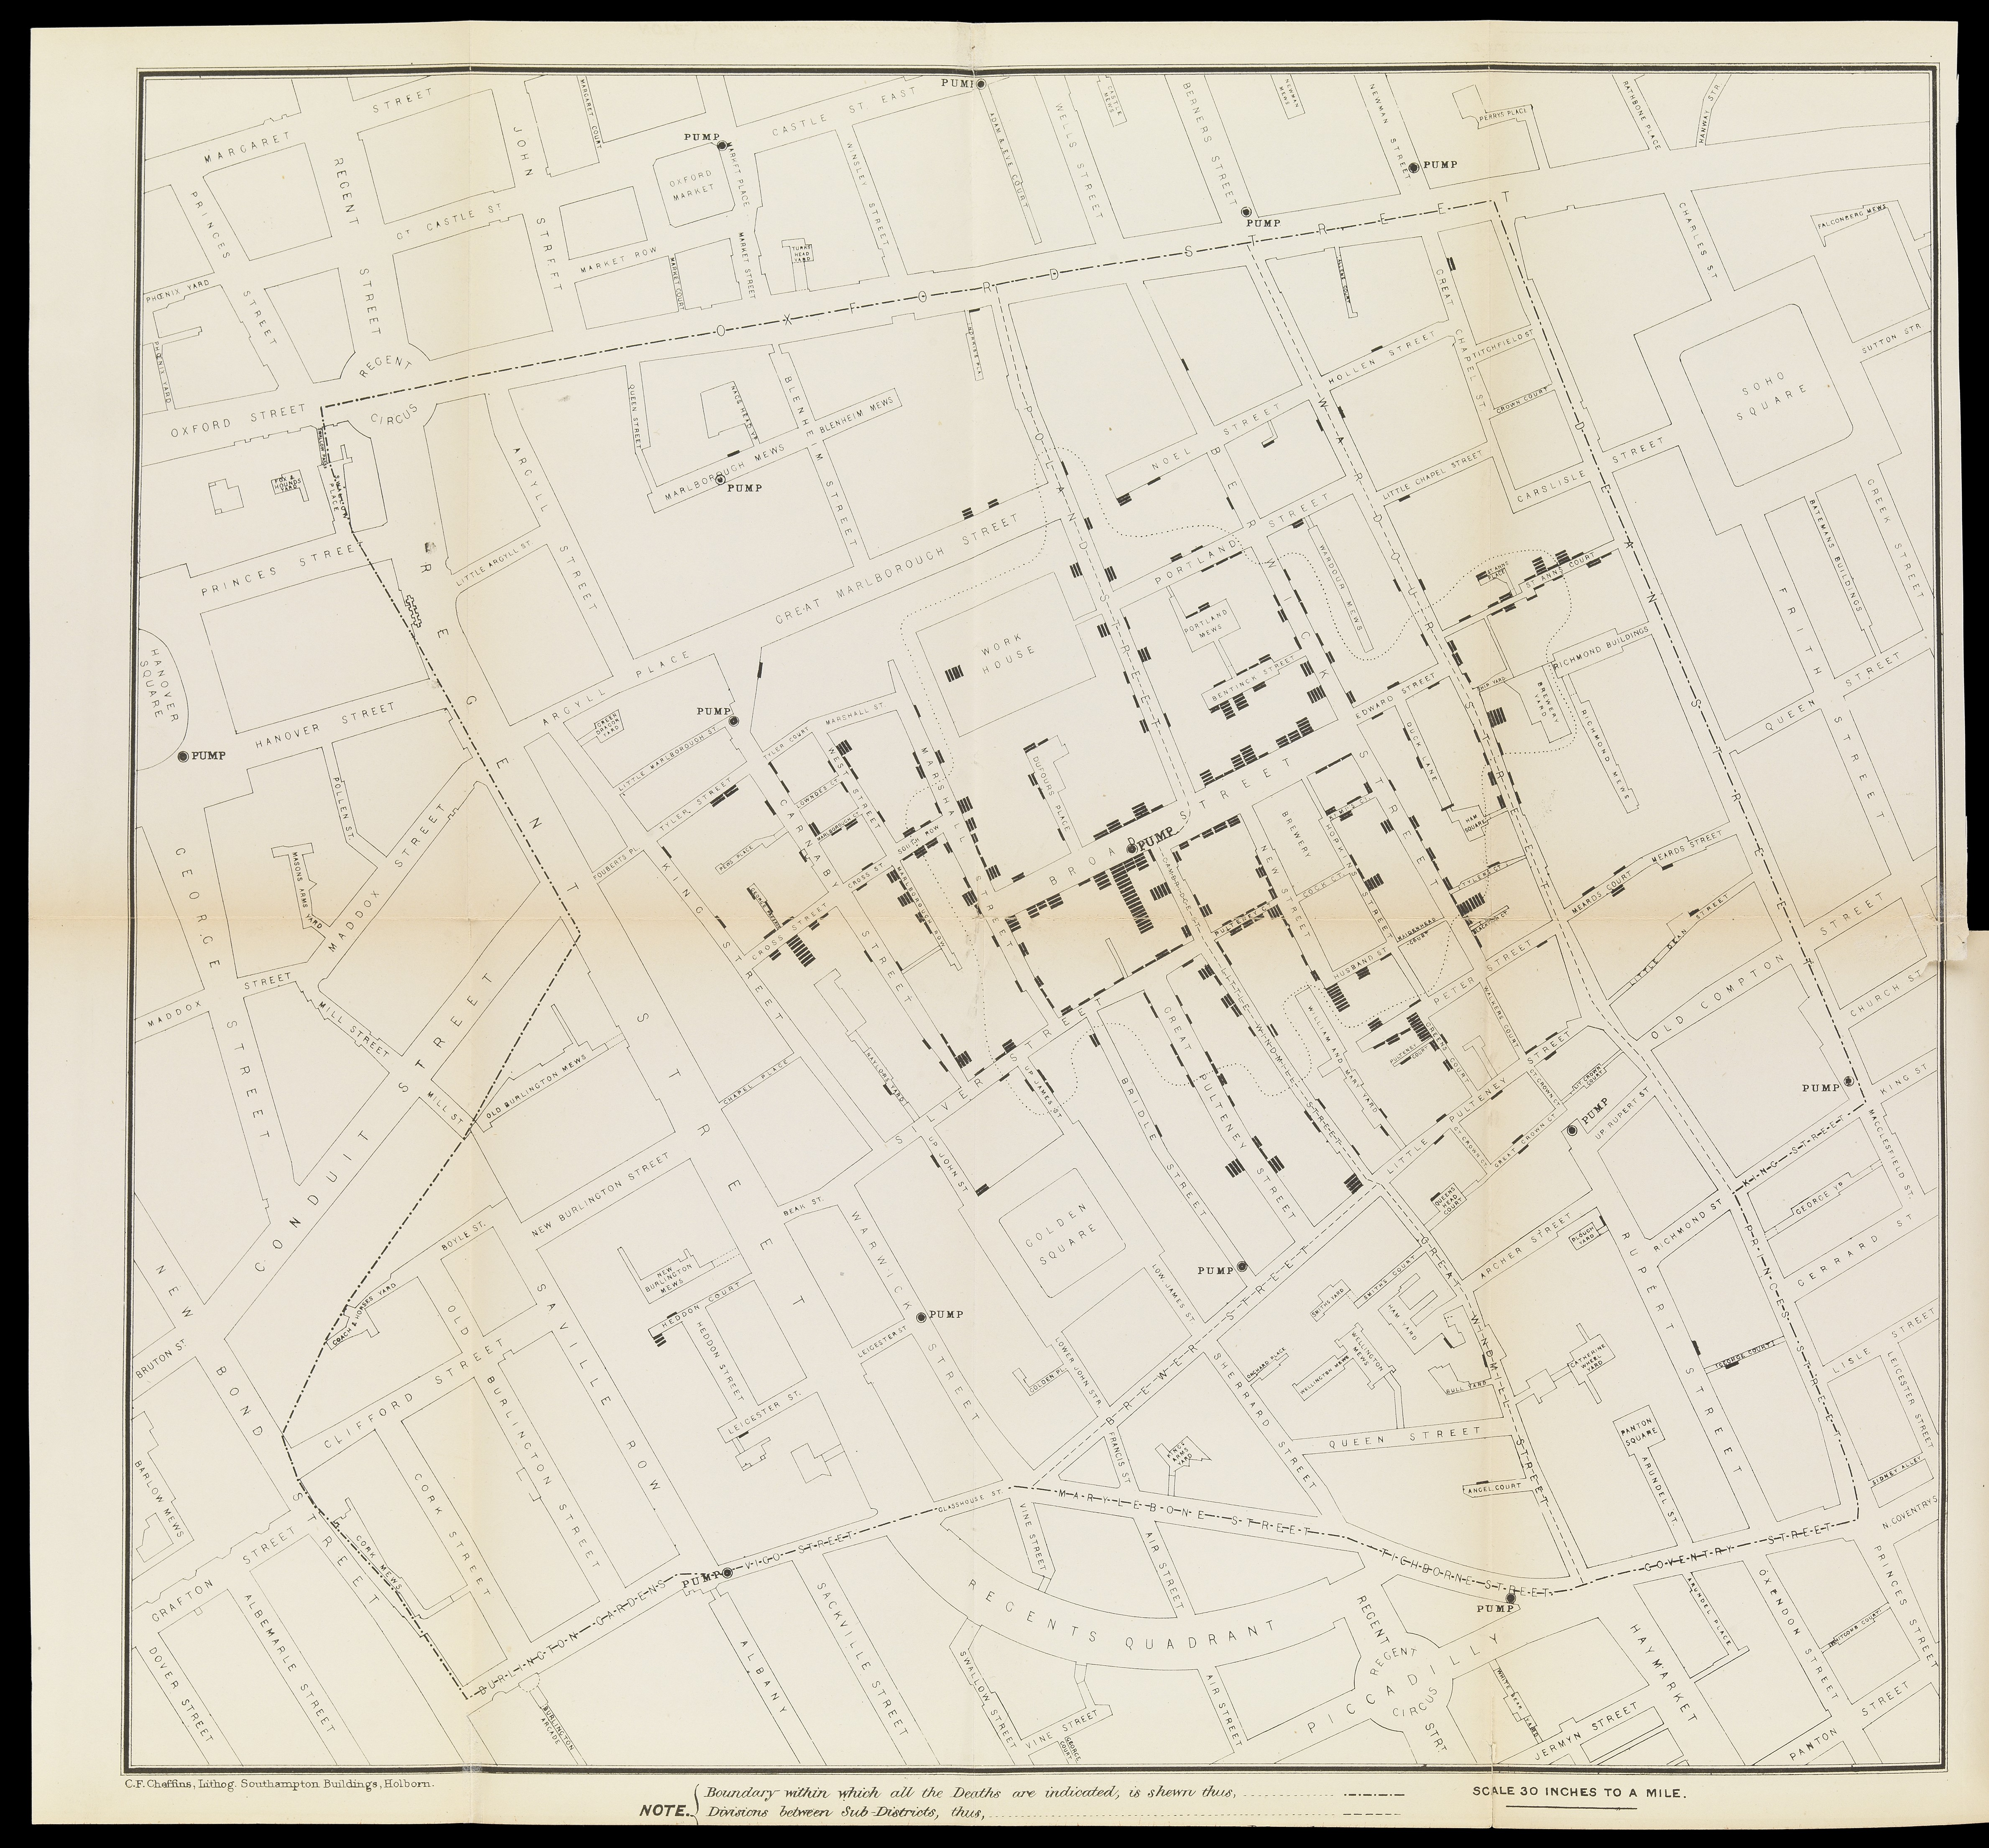
One of the greatest data story visualisations of all time:
In 1855 John Snow was tracing Soho Cholera outbreak
Correctly identified contaminated water as reason for decease
Convinced people with this figure
Changed city planning and sanitation
More here

Slide 5
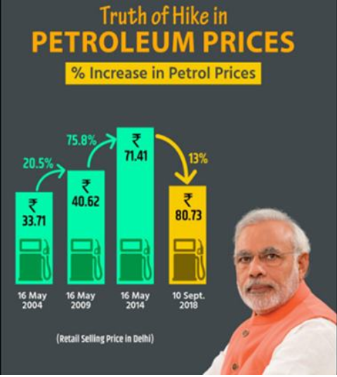
The bad - What can go wrong?
Deliberate misleading
Pretending prices have come down when they haven’t
More here

Slide 6
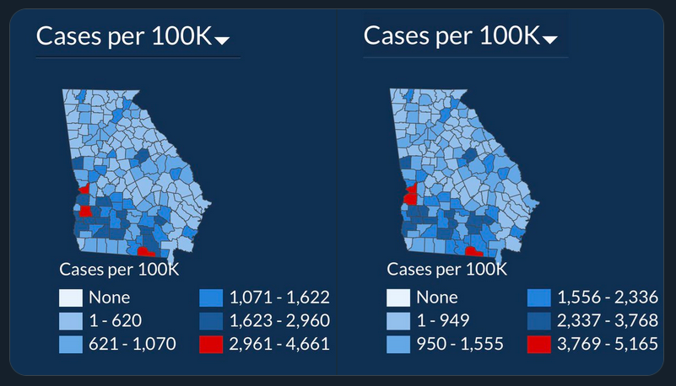
The bad - What can go wrong?
From the US State of Georgia
July 2
July 17
Deliberate misleading
Incompetence
Figure seems to tell the story that COVID situation hasn’t changed much (when it has)
More here

Slide 7
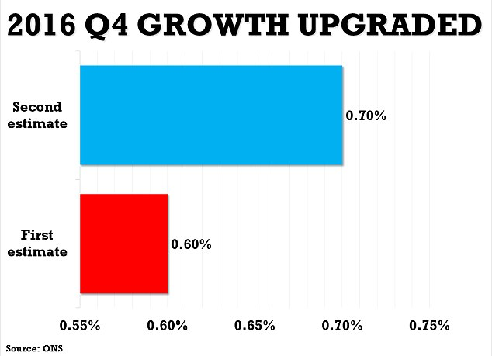
The bad - What can go wrong?
Deliberately misleading
Pretending that something is a bigger deal (when it isn’t)

Slide 8
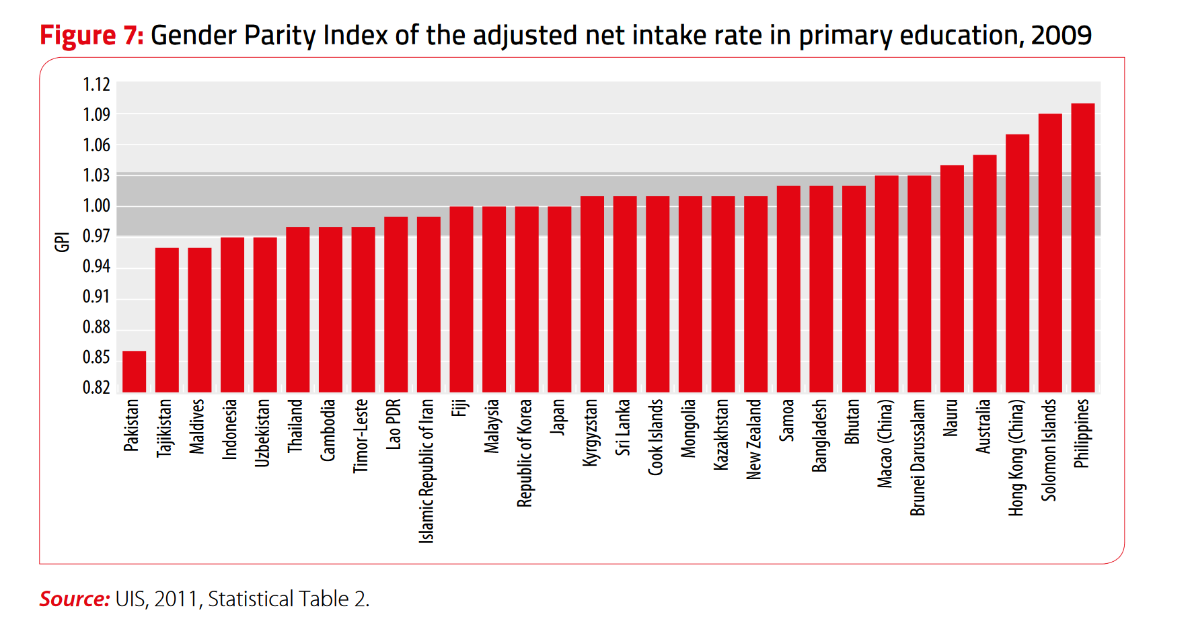
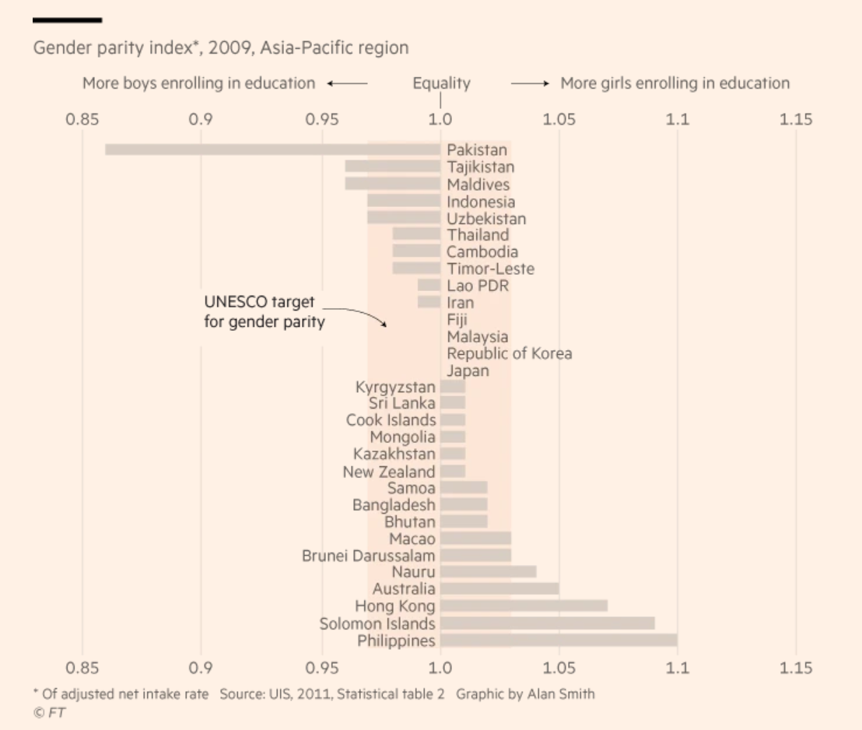
The bad – What can go wrong?
Looks like the Philippines are doing best?
This might be a better way (more discussion here)

Slide 9

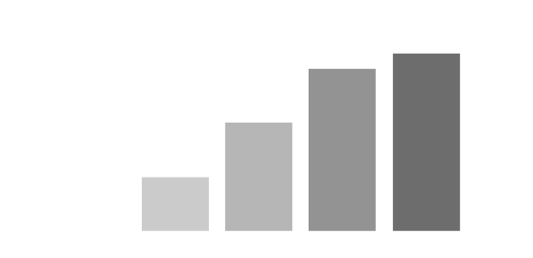
Un-necessary clutter: The case of texture..

Slide 10
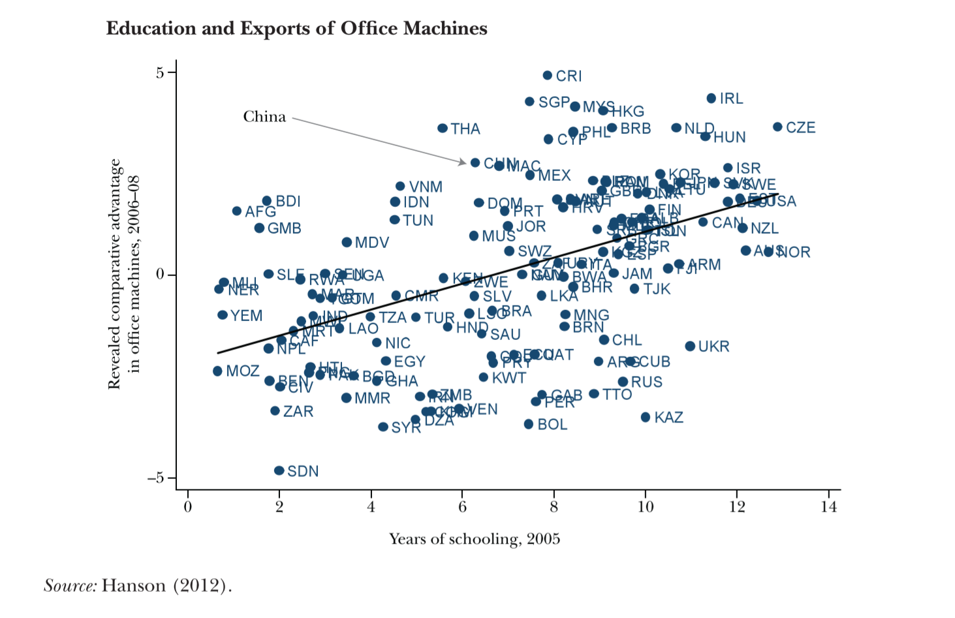
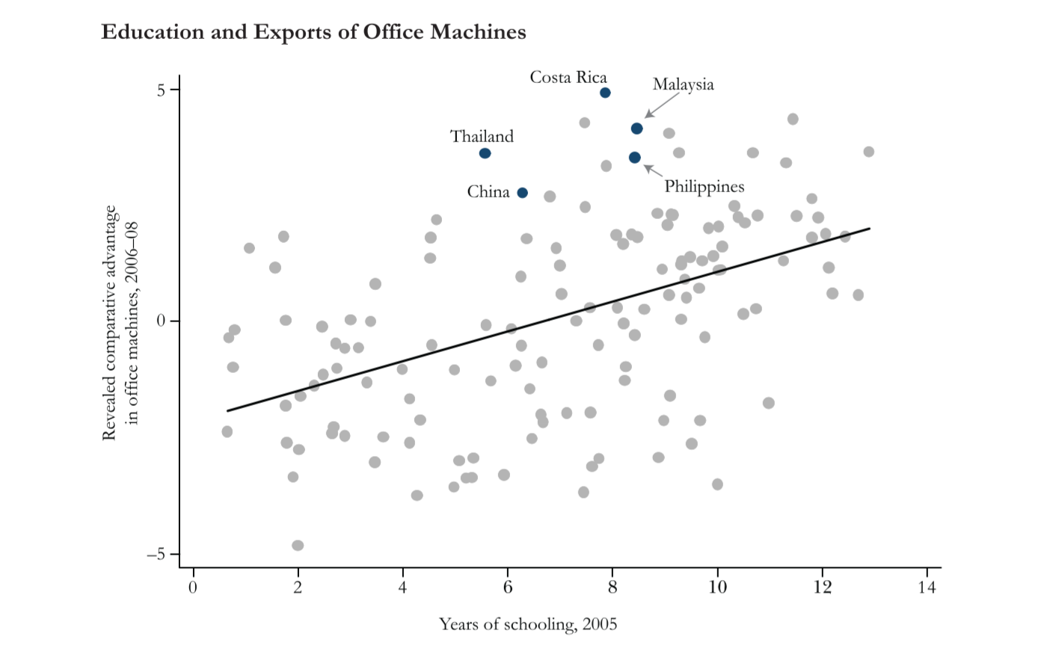
Showing the data…..
Showing less to see more

Slide 11
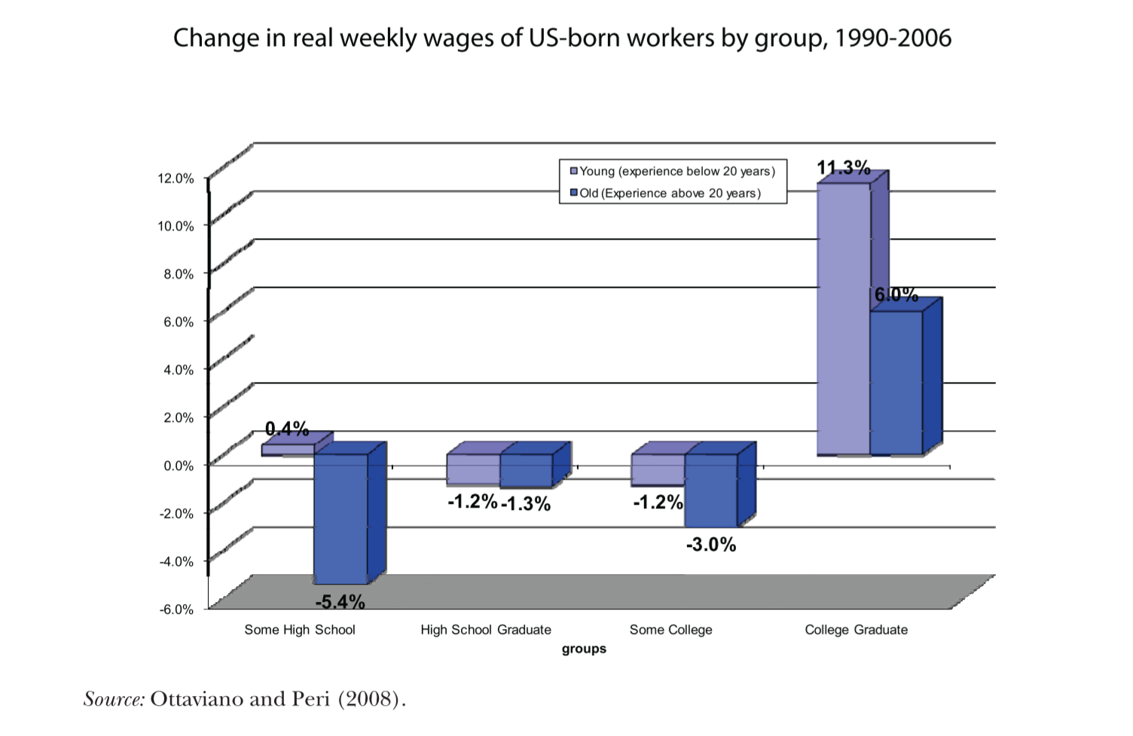
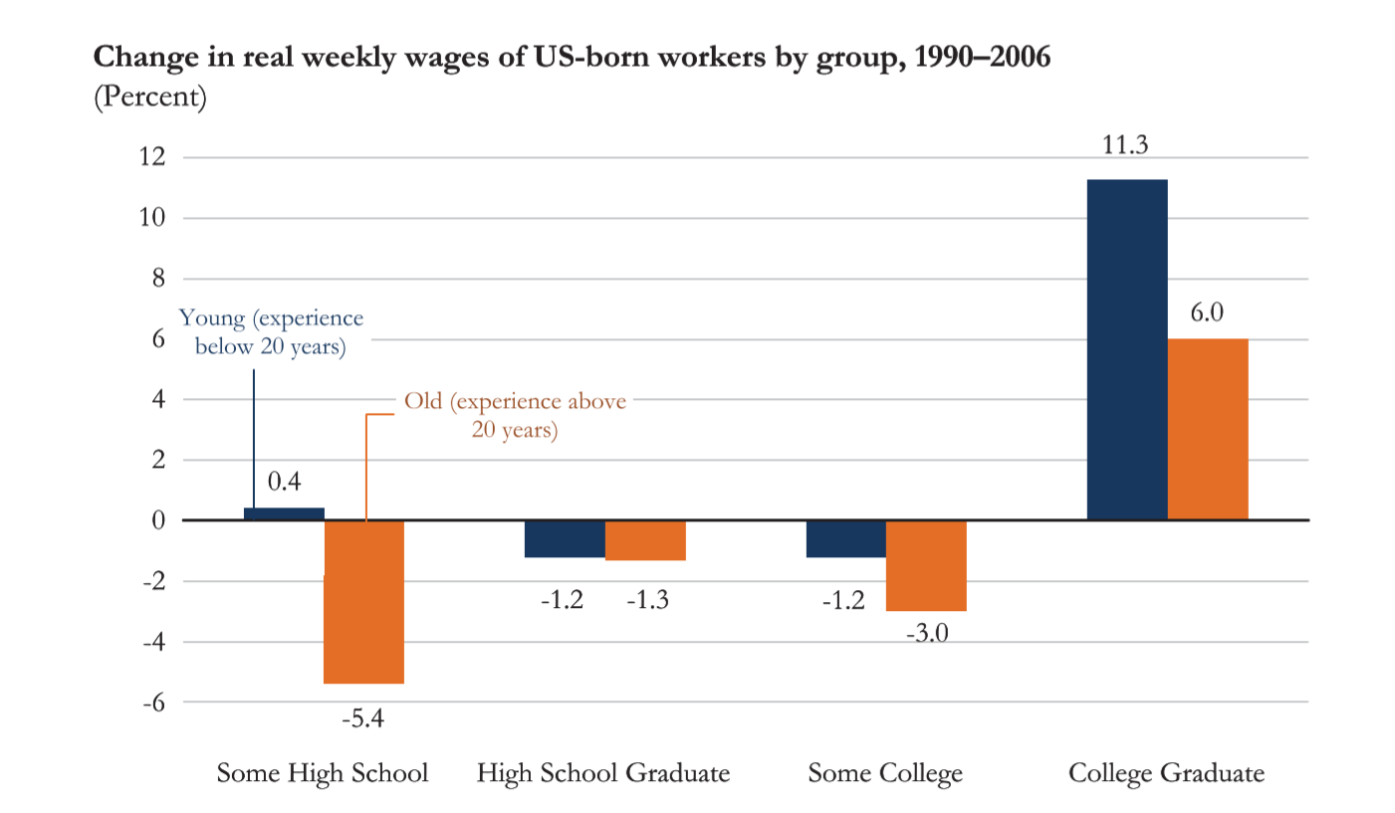
3 dimensions
2 dimensions can often provide more or clearer information than 3
Keep text close to relevant visuals

Slide 12
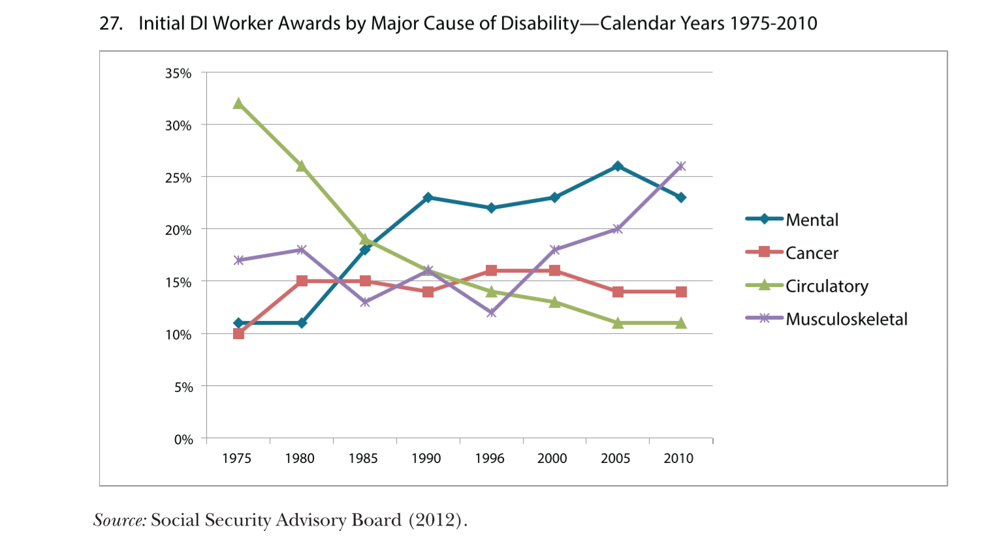
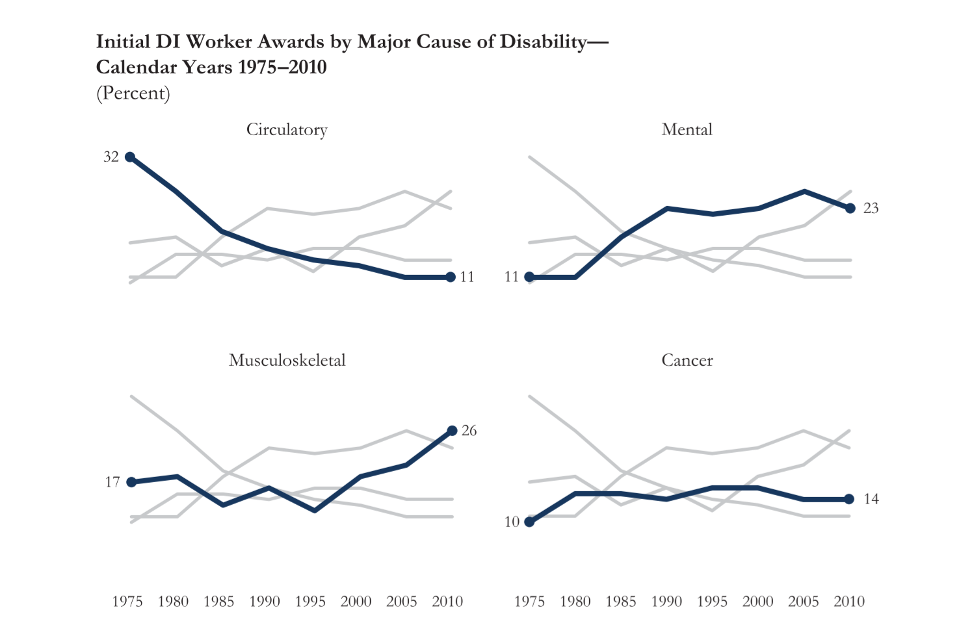
Spagghetti…..

Slide 13
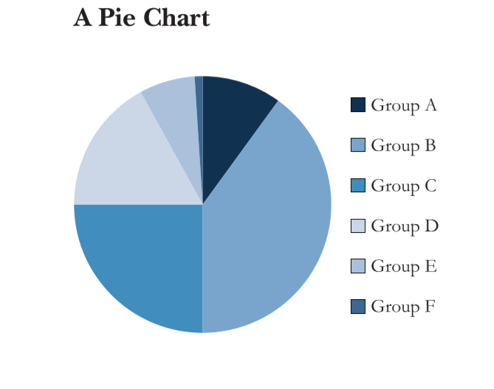
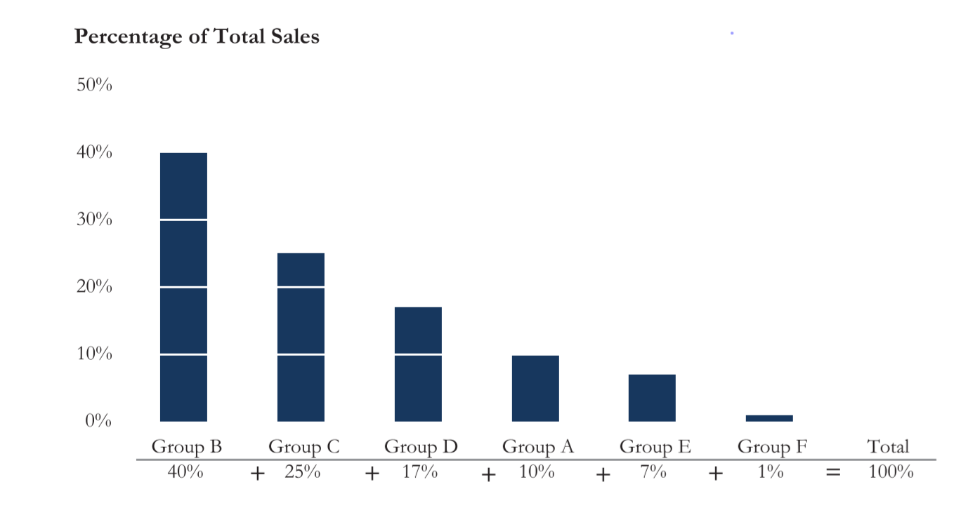
…and pie
Label close to visuals
Also report numbers
Maybe eating less pie is better for you?

Slide 14
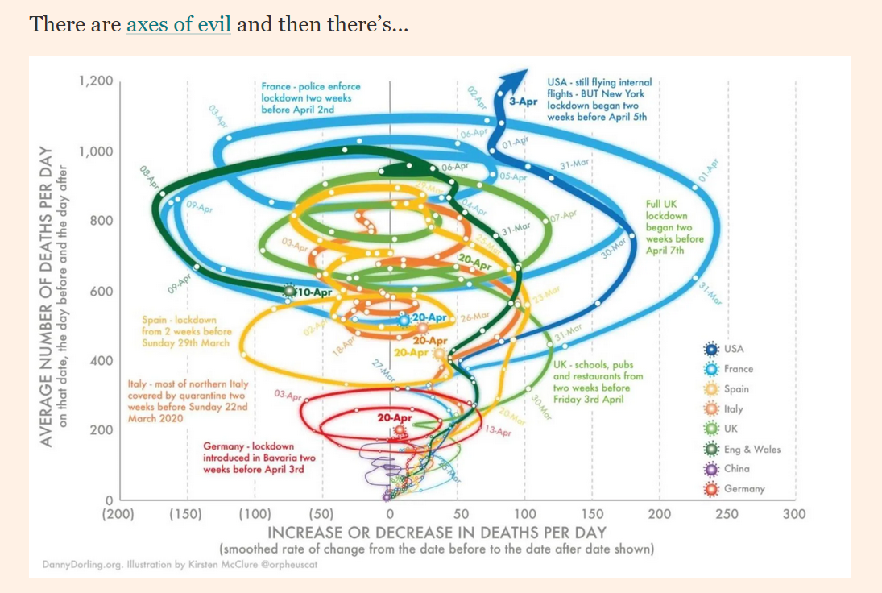
The bad – What can go wrong?
Looks kind of cool but what does it tell us?
For many more examples consult the FT’s chart doctor

Slide 15
Some principles
Show the data….but not necessarily all of the data
The visual part should accurately reflect that message of the data
The less clutter the better
Integrate text and data
Don’t lie….deliberately or accidentally

Slide 16
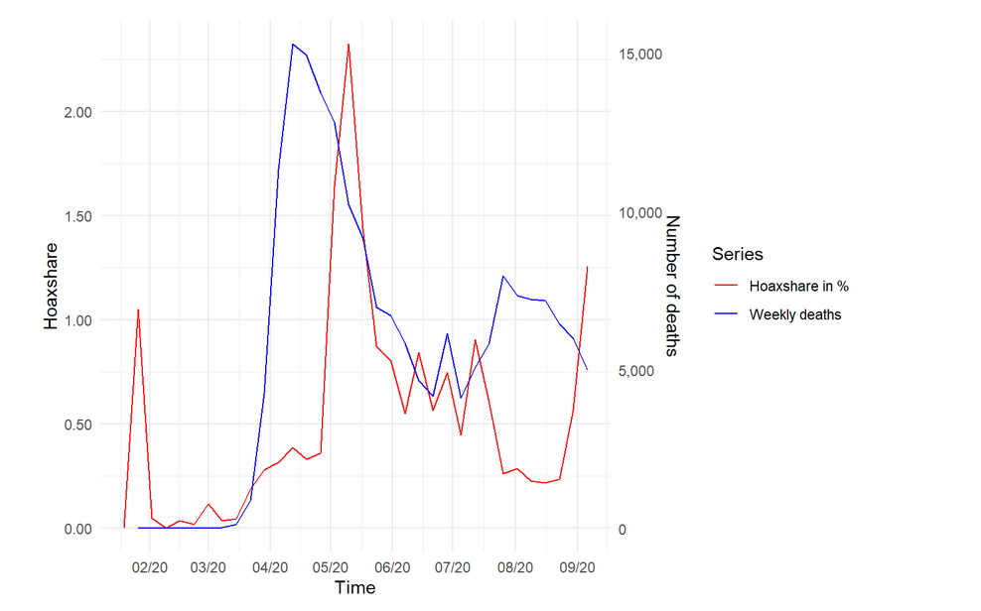
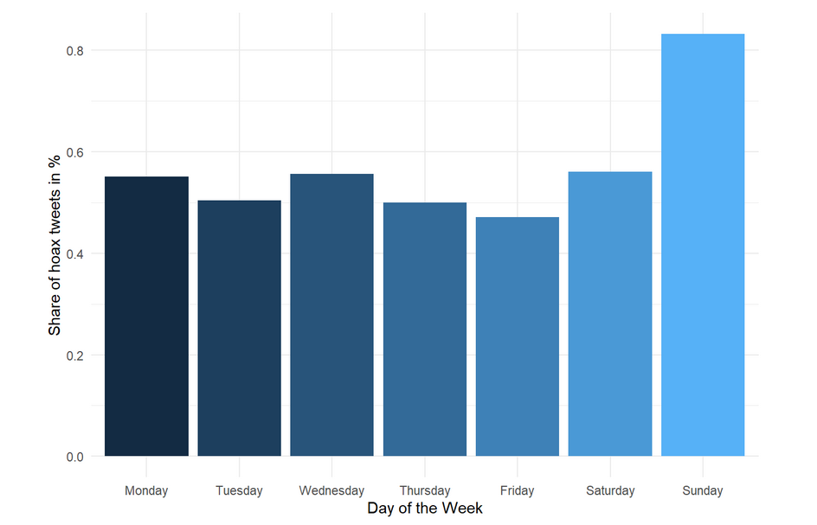
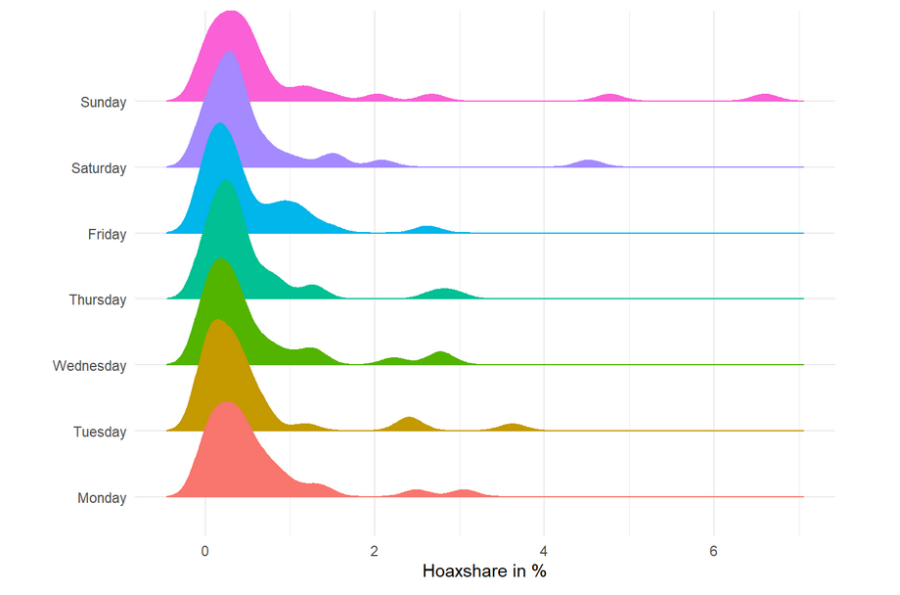
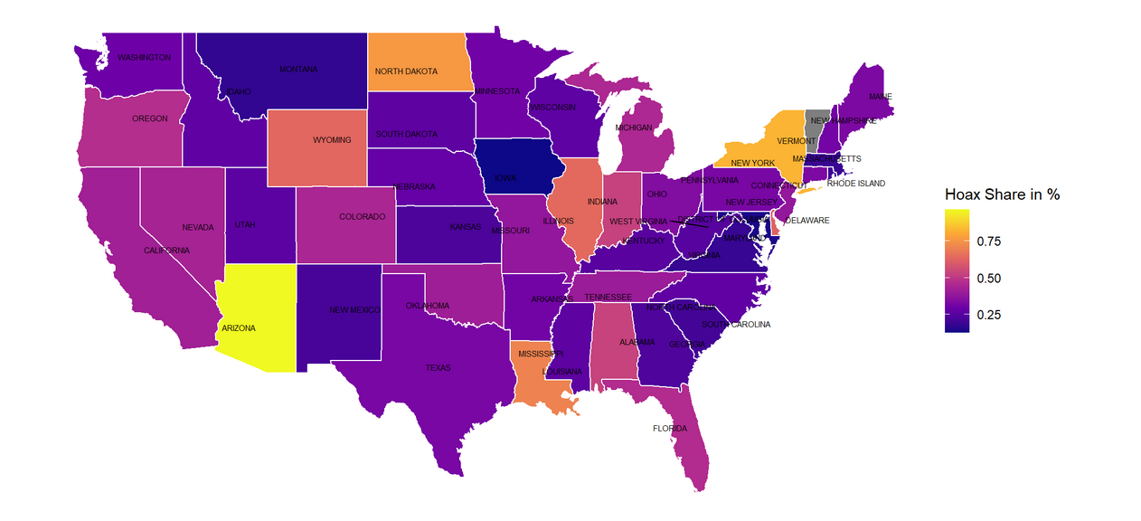
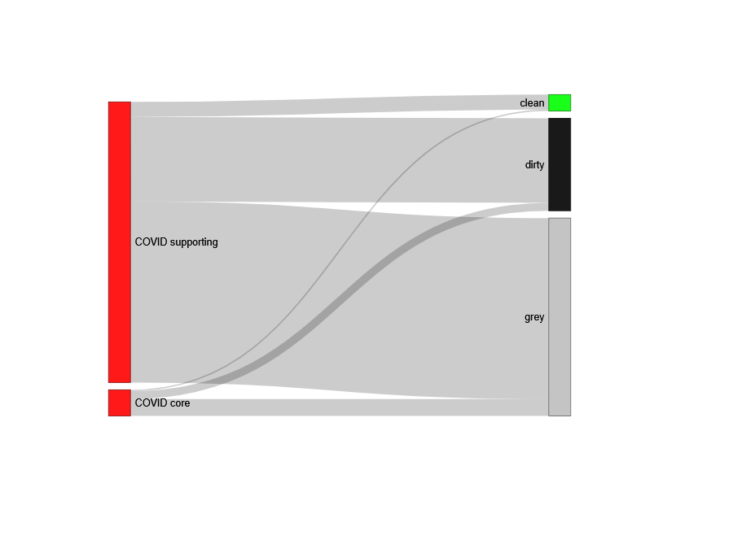
More visions (check here)
Time Series
Bar chart
Histogram
Density histogram
Density Plot
Map
Integrating javascript

Slide 17

Takeaways
R is great for doing visualisations
Have a go yourself:
Find some data
Make a nice diagram with R Markdown
Tell some story with it (with R Markdown)
Post to RPubs as well as the Datathon Visualisation Challenge 2021
To find data you can have a look at the Data Resources Channel
If you are on twitter you can share @datastorieshub

Slide 18
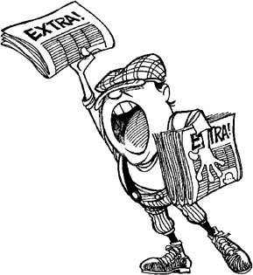
Extra Slides

Slide 19
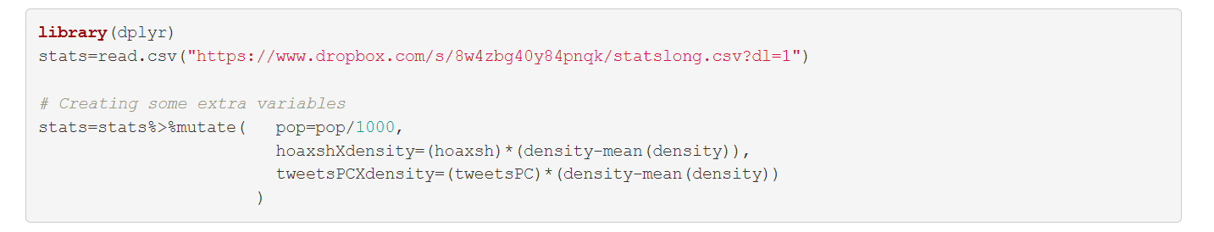
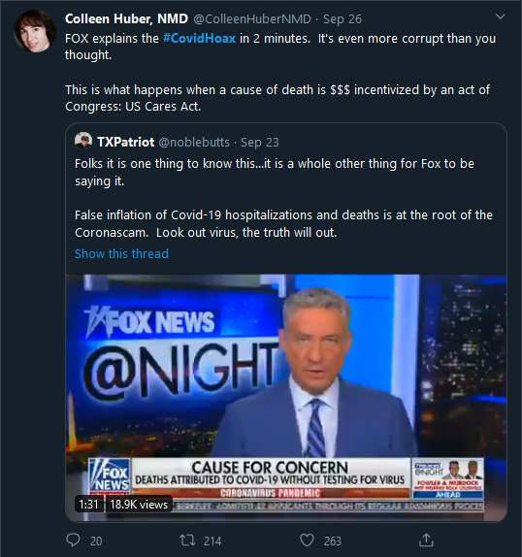
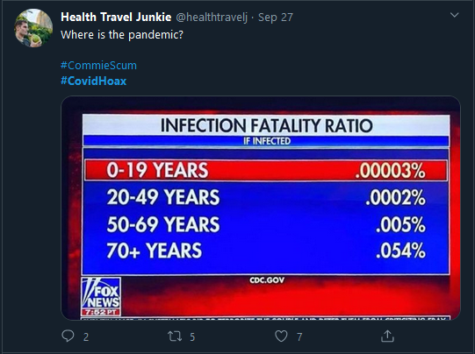
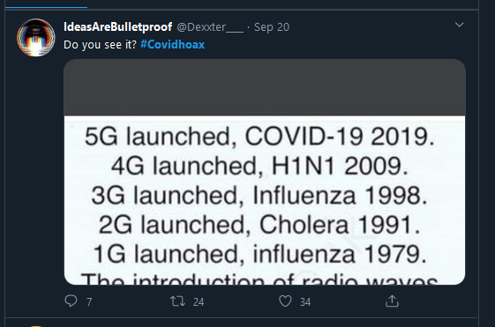
R visuals – Let’s get some data for examples
Data on COVID hoaxism
Rmd file with code for this lecture
html file

Slide 20
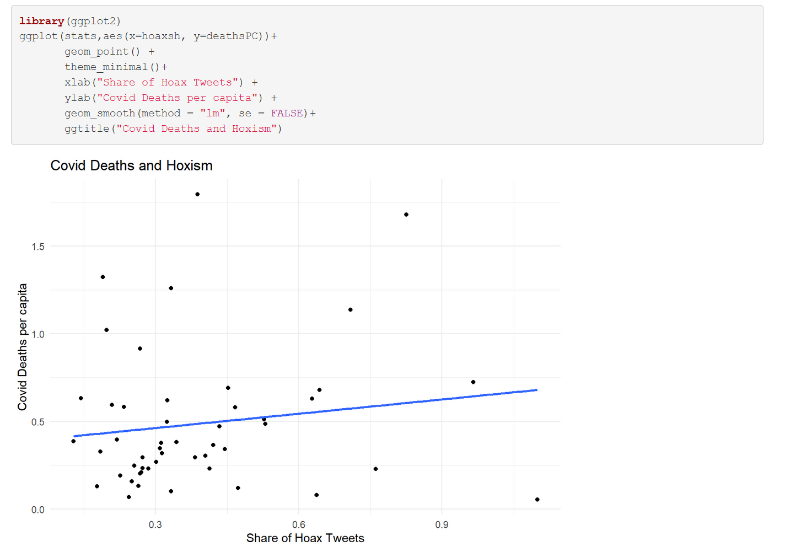
Scatter ggplot– The relationship between COVID hoaxism and deaths

Slide 21
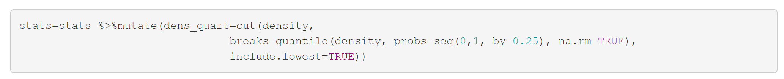
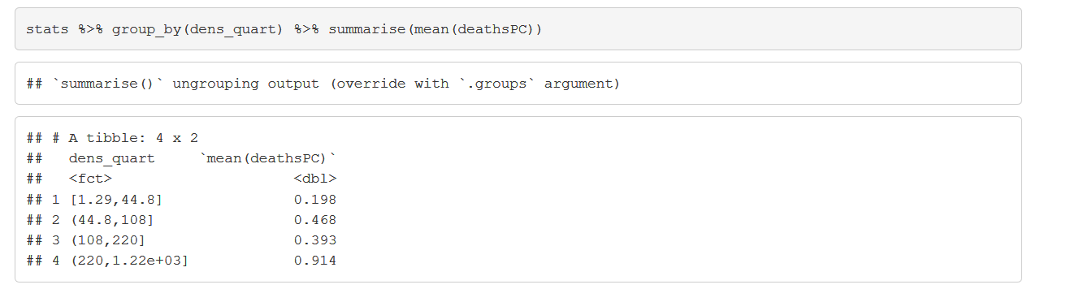
Adding twists to your scatter plot story
If hoaxism causes deaths we might expect this to be worse in more densely populated regions
Creating quartile bins of the population density variables

Slide 22
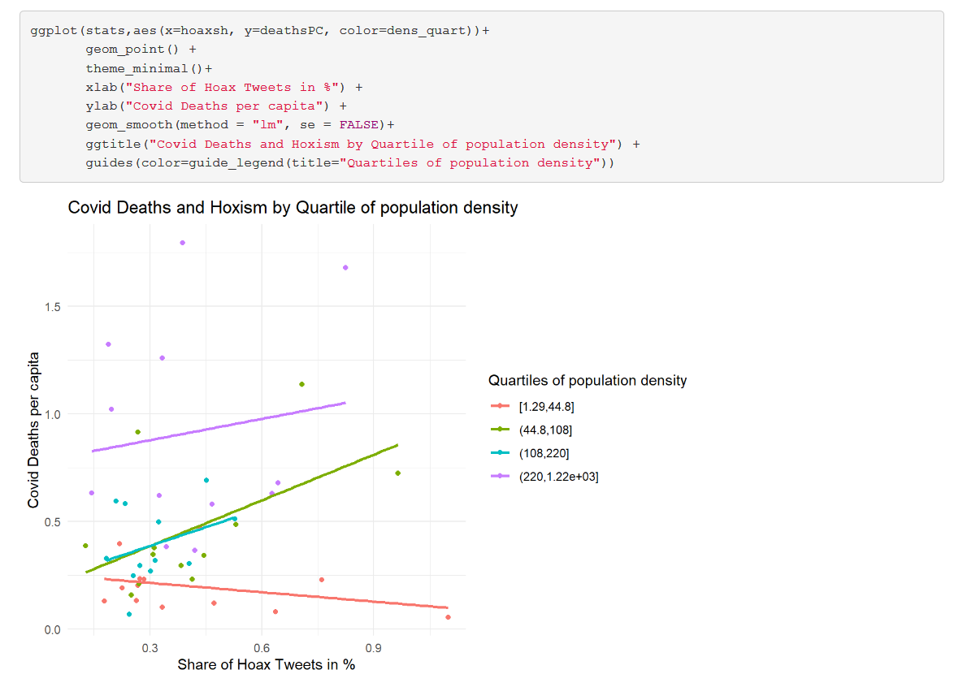
A lot more story with very little more code
That’s all

